Slide 1
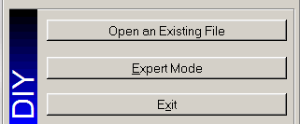
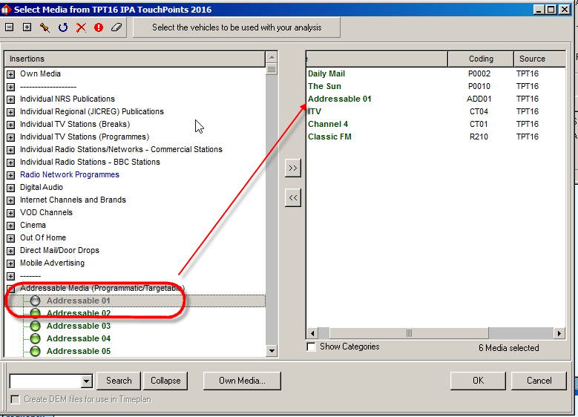
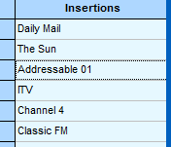
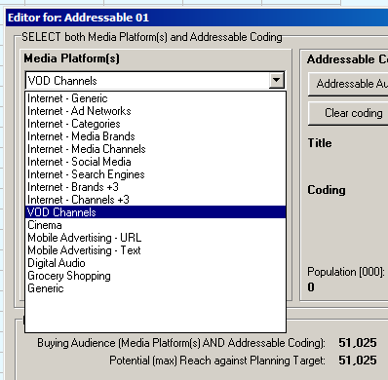
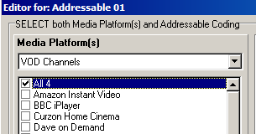
..include Addressable Media in a Multi-Media Schedule in TouchPoints?
We are pleased to announce that we have introduced new functionality in MediaPlanner+ to allow users to include Programmatic/Targetable/Addressable media in a campaign, alongside traditional media. Various terms are used for this; we’ve chosen to use the label ‘Addressable Media’.
Addressable Media are buyable target audiences, usually a combination of a specific target group with an existing media platform (for example internet, mobile or VOD). The target group can be defined by demographics, geodemographics, media behaviour, product usage or any other audience that the media owner can deliver (and which can be defined on the TouchPoints survey).
You can then input the number of impressions against that ‘buying audience’ and see the reach and frequency updated for your entire campaign.
• Select MediaPlanner+ and click on ‘Expert Mode’ (Figure 1).
• Click on the ‘Target’ button located at the top of the screen (Figure 2) and then click on the ‘New Target’ button located in the bottom left corner (Figure 3). Select your TouchPoints survey.
• Once the survey is highlighted click on the ‘OK’ button in the bottom right, then code your audiences. For this example we used two audiences: ‘All Respondents’ and ‘Men Aged 35+’ (Figure 4).
• Then select the ‘Next’ button in the bottom right corner.
• On the media selection screen we have picked some print, TV and radio - and then an addressable media ‘slot’, as shown in Figure 5. We will populate one of these shortly.
• Click ‘OK’ and input your traditional media plan e.g. print insertions, radio and TV GRP’s as usual.
• Next we are going to configure our addressable medium: we’re going to use Channel 4’s All 4 VOD to target ABC1s. Double-click on the words ‘Addressable 01’ (Figure 6) to get to the Editor screen (Figure 7).
• From the Media Platform(s) list, select ‘VOD Channels’, then select the specific channel we are buying: All 4 (Figure 8).
Figure 1
Figure 2
Figure 3
Figure 4
Figure 5
Figure 6
Figure 7
Figure 8

Slide 2
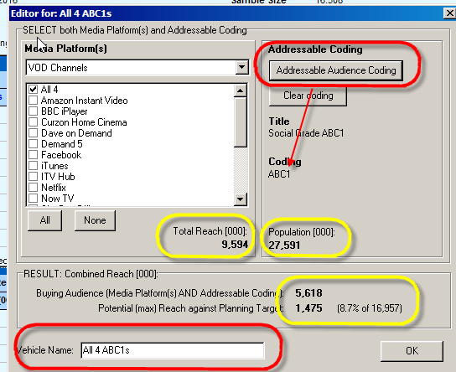
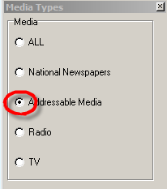
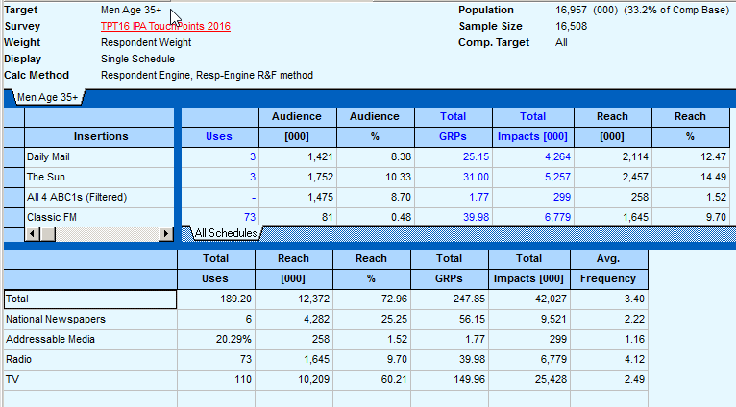
Now that we have chosen All 4 we can select the demographic that we are buying. Click on ‘Addressable Audience Coding’ (Figure 9) and use the standard Touchpoints coding screen to select Social Grade ABC1 (Figure 10), then click ‘Next’.
Note that the audience sizes are being updated as you go. See the figures highlighted in yellow in Figure 9:
All 4 has a total reach of 9,594 (000s Adults 15+)
There are 27,591 ABC1s
All 4 reaches 5,618 ABC1s
Of those, 1,475 are also Men Aged 35+. This is the maximum potential reach of your custom medium against your planning target (the 16,957 Men Aged 35+).
• Rather than using the generic name ‘Addressable 01’, you can now input a custom name for your custom vehicle at the bottom of the Editor screen (Figure 9). Now click ‘OK’.
• In the main planning screen, select ‘Addressable Media’ from the Media Types box (Figure 11). You can now see the extra input columns ‘Buying Impressions’, ‘Buying GRPs’ and ‘Frequency Capping’. Note that Buying Impressions and Buying GRPs are calculated against your ‘All4 ABC1s’ buying audience of 5,618, not the planning target.
• Input your buying impressions and, if applicable, set a maximum frequency per individual (Figure 12).
• In Media Types, select ‘ALL’ media again. Figure 13 shows the overall reach & frequency results and the reach achieved by the the 2000 ABC1 VOD impressions adults within the target audience
Figure 10
Figure 9
Figure 11
Figure 12
Figure 13

